Slide 1


Human Data Analytics Course Final Project
DETECTING COVID-19 AND PNEUMONIA FROM CHEST X-RAY IMAGES X-ray
Prof. Michele Rossi
Physics of data
Asal Rangrasiasl - 2046832
Roya Joulaei- 2050954
22/02/2023

Slide 2


INTRODUCTION
AIM OF THE PROJECT
MATERIAL AND METHODS
DATASET
METHODOLOGY
RESULTS
CONCLUSION & QUESTIONS
CONTENTS

Slide 3



INTRODUCTION
As the need for medical treatments grows exponentially, there has been an unprecedented demand for the quick diagnosis of illnesses.
This study proposes a computer-aided diagnosis system for automatic disease detection using Chest X- ray images of three classes COVID-19, Pneumonia, and Healthy.
The prediction can be done through deep learning algorithms, such as convolutional neural networks (CNNs). The algorithms are trained on a large dataset of X-ray images and can accurately classify the images into different disease categories

Slide 4




AIM OF THE PROJECT
Proposed Method :
A CNN model would take an X-ray chest image as input and then classify the image into different categories, such as ”normal” or ”covid” and ”pneumonia”.
Feature Extraction :
CNN uses filters to scan the input image and extract local features, such as edges and shapes
Evaluate:
Training and Validation accuracy of CNN for classification, Precision , Recall , F1-score and confusion matrix

Slide 5




MATERIAL AND METHODS
Understanding The Context
Retrieving The Data
Dataset Preparation
Building Models and Training
Evaluation of Models and Reporting
study about different methods for classification of x-chest
Chest X-ray PA DatasetPaper published by Amanullah Asraf, Zabirul Islam
Adding the labels for each group of dataset
We built two models to compare and evaluate for the best: CNN and pre-trained DenseNet.
As a final result, we produced and compared accuracy and loss plots and confusion matrix.

Slide 6
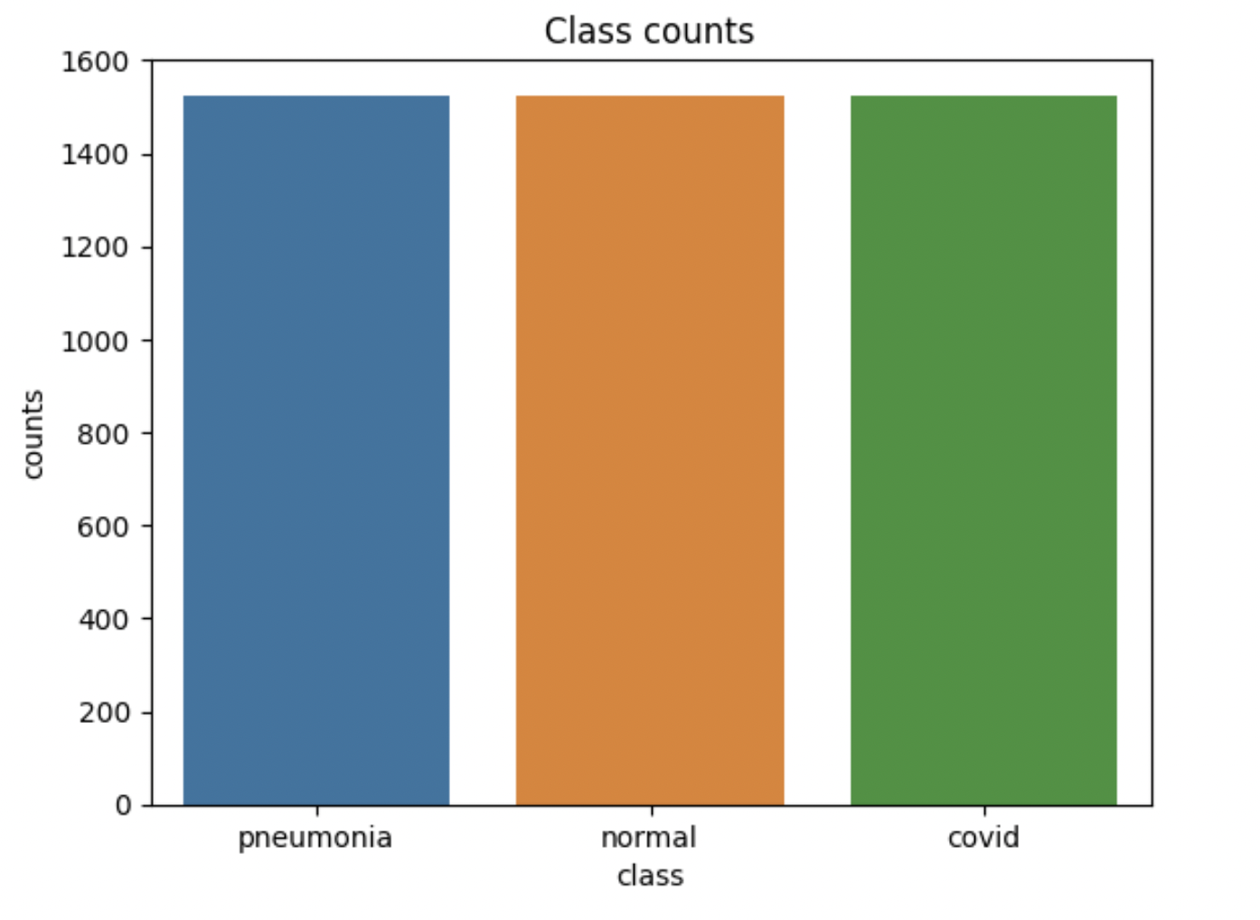
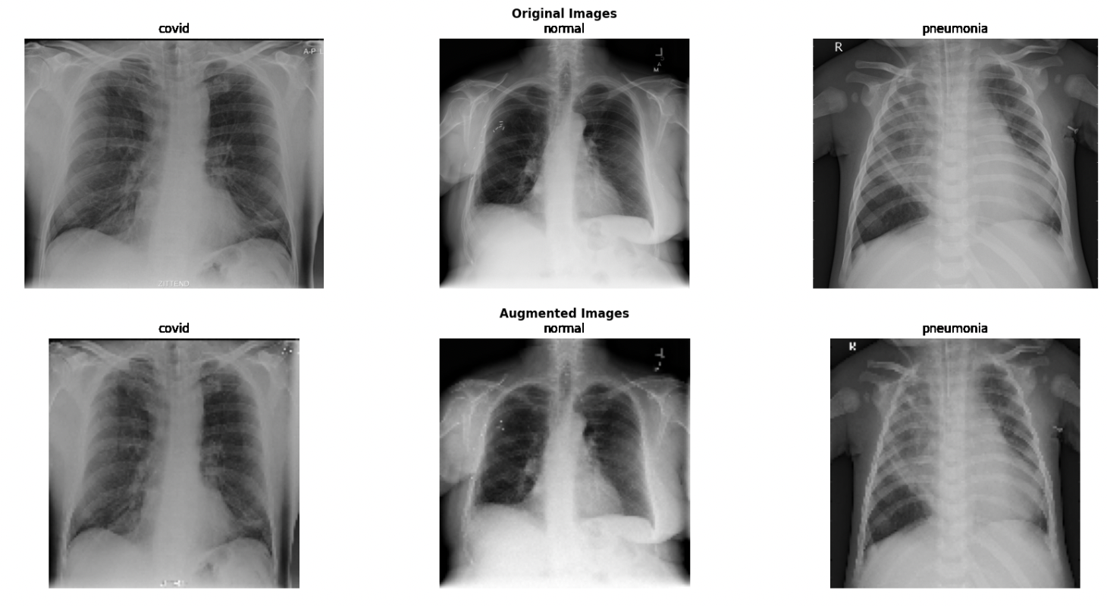
DATASET DESCRIPTION
Chest X-ray PA Dataset: The dataset consist of 1525 chest x-ray images per each class which sums up to 4575 in total
- Data augmentation
- Splitting: 70% training, 30% testing.
Class 0
COVID-19
Class 1
NORMAL
Class 2
PNEUMONIA

Slide 7
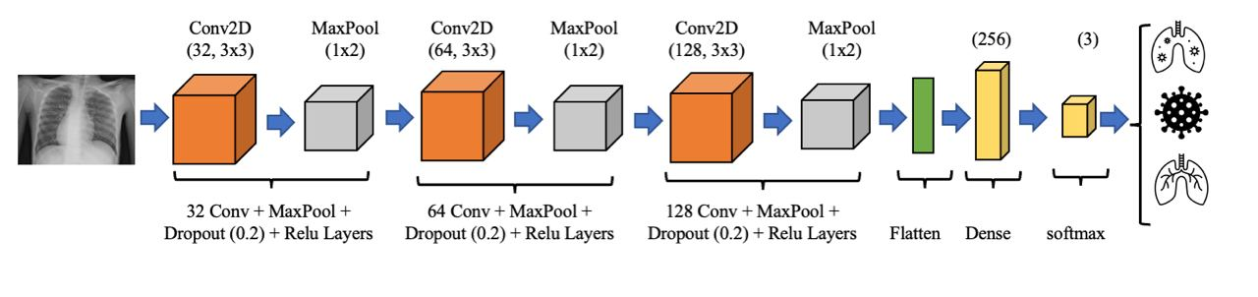
METHODOLOGY: CNN
Convolutional Neural Network (CNN)
- Commonly used for image classification tasks.
- A CNN consists of multiple layers, including convolutional layers, activation layers, and pooling layers, that extract and simplify the features in an image, reducing the dimensionality of the data and making it easier to classify.

Slide 8
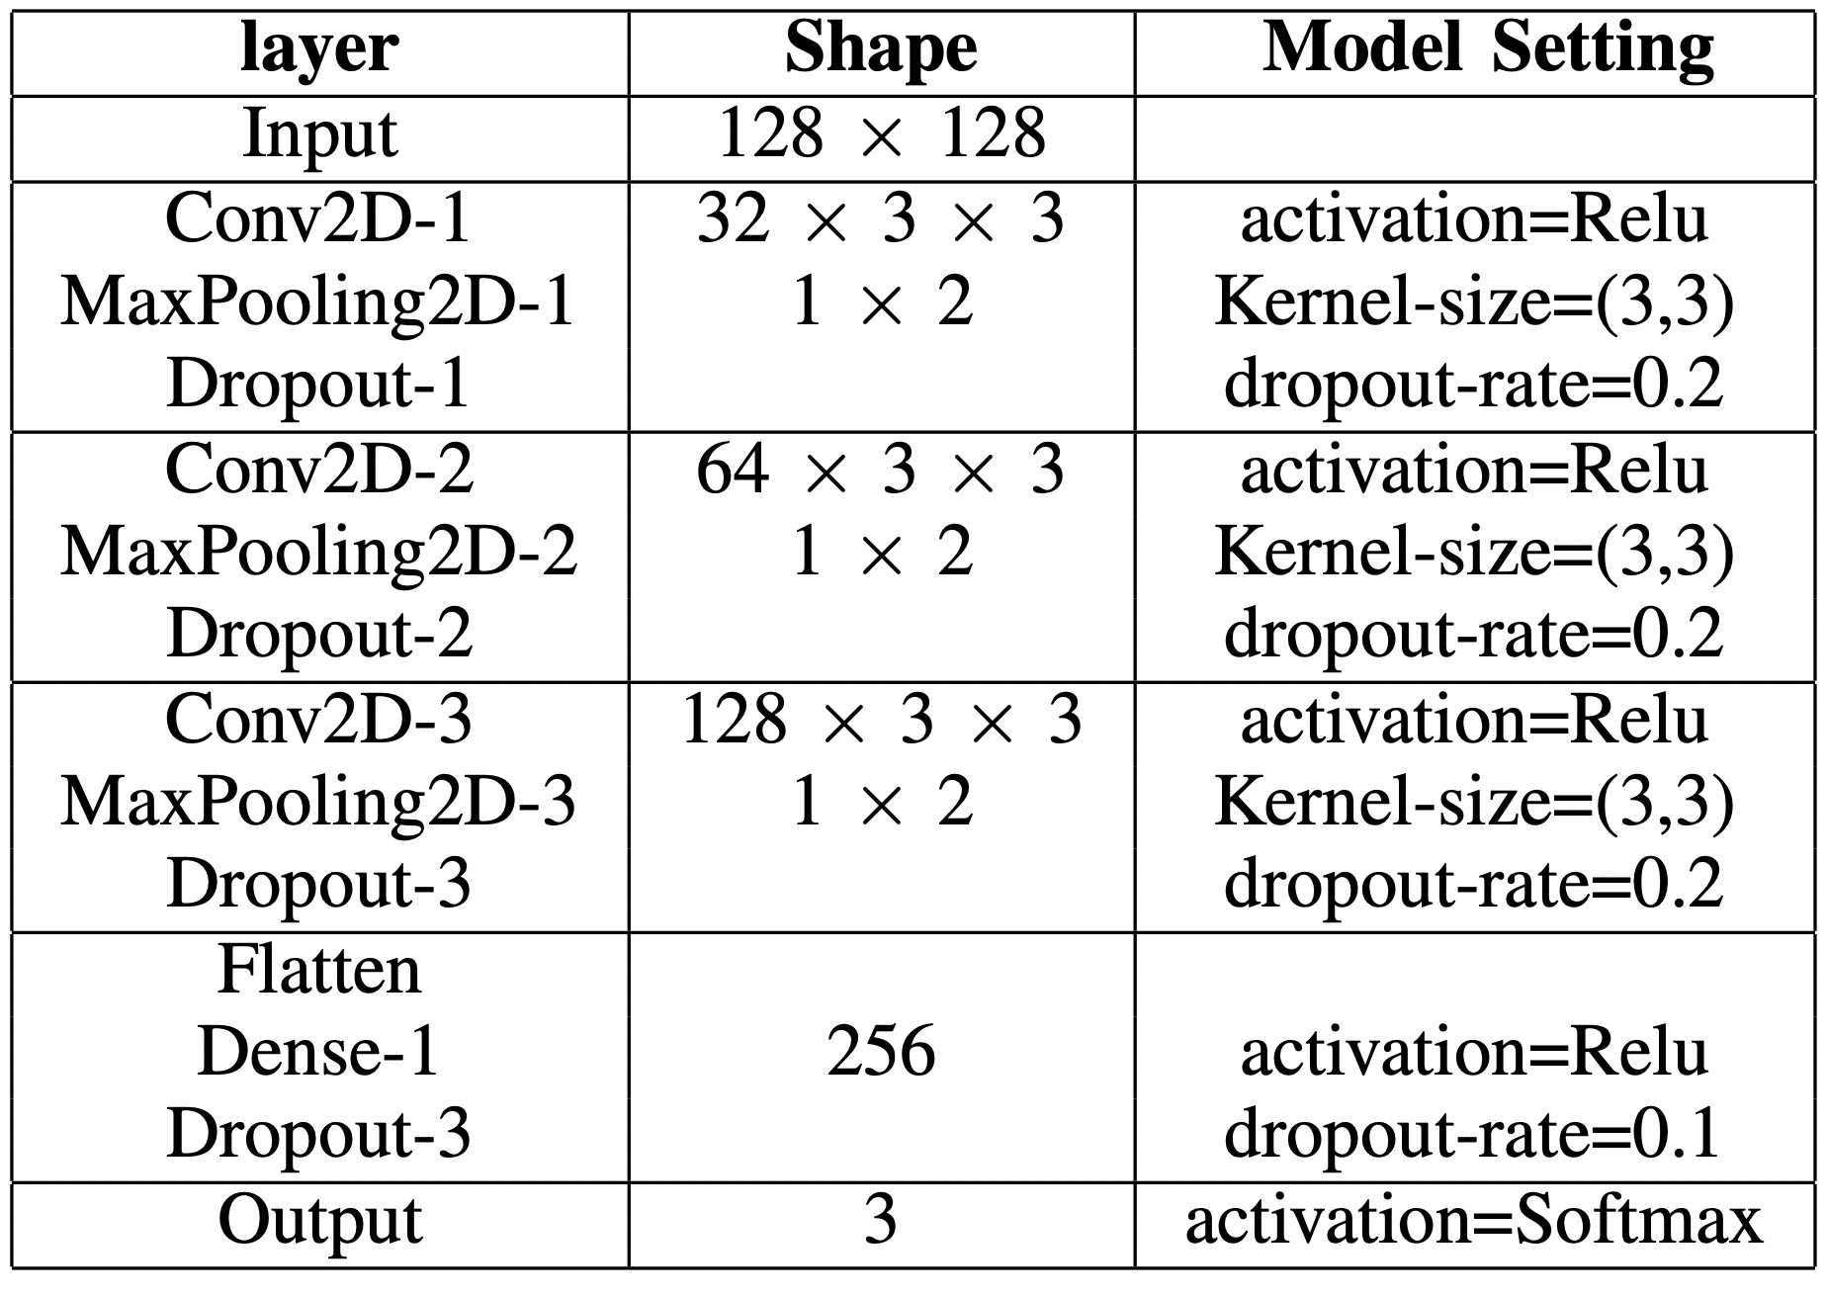
METHODOLOGY: CNN
A CNN model would take an X-ray chest image as input and then classify the image into different categories, such as ”normal” or ”covid” and ”pneumonia”.
Kernel
Size=(3,3)
Dropout
Rate = 0.2 , 0.1
Batch size
32
epoch
20
Optimizer
Adam
Learning rate = 0.0001
Loss
Categorical cross entropy

Slide 9
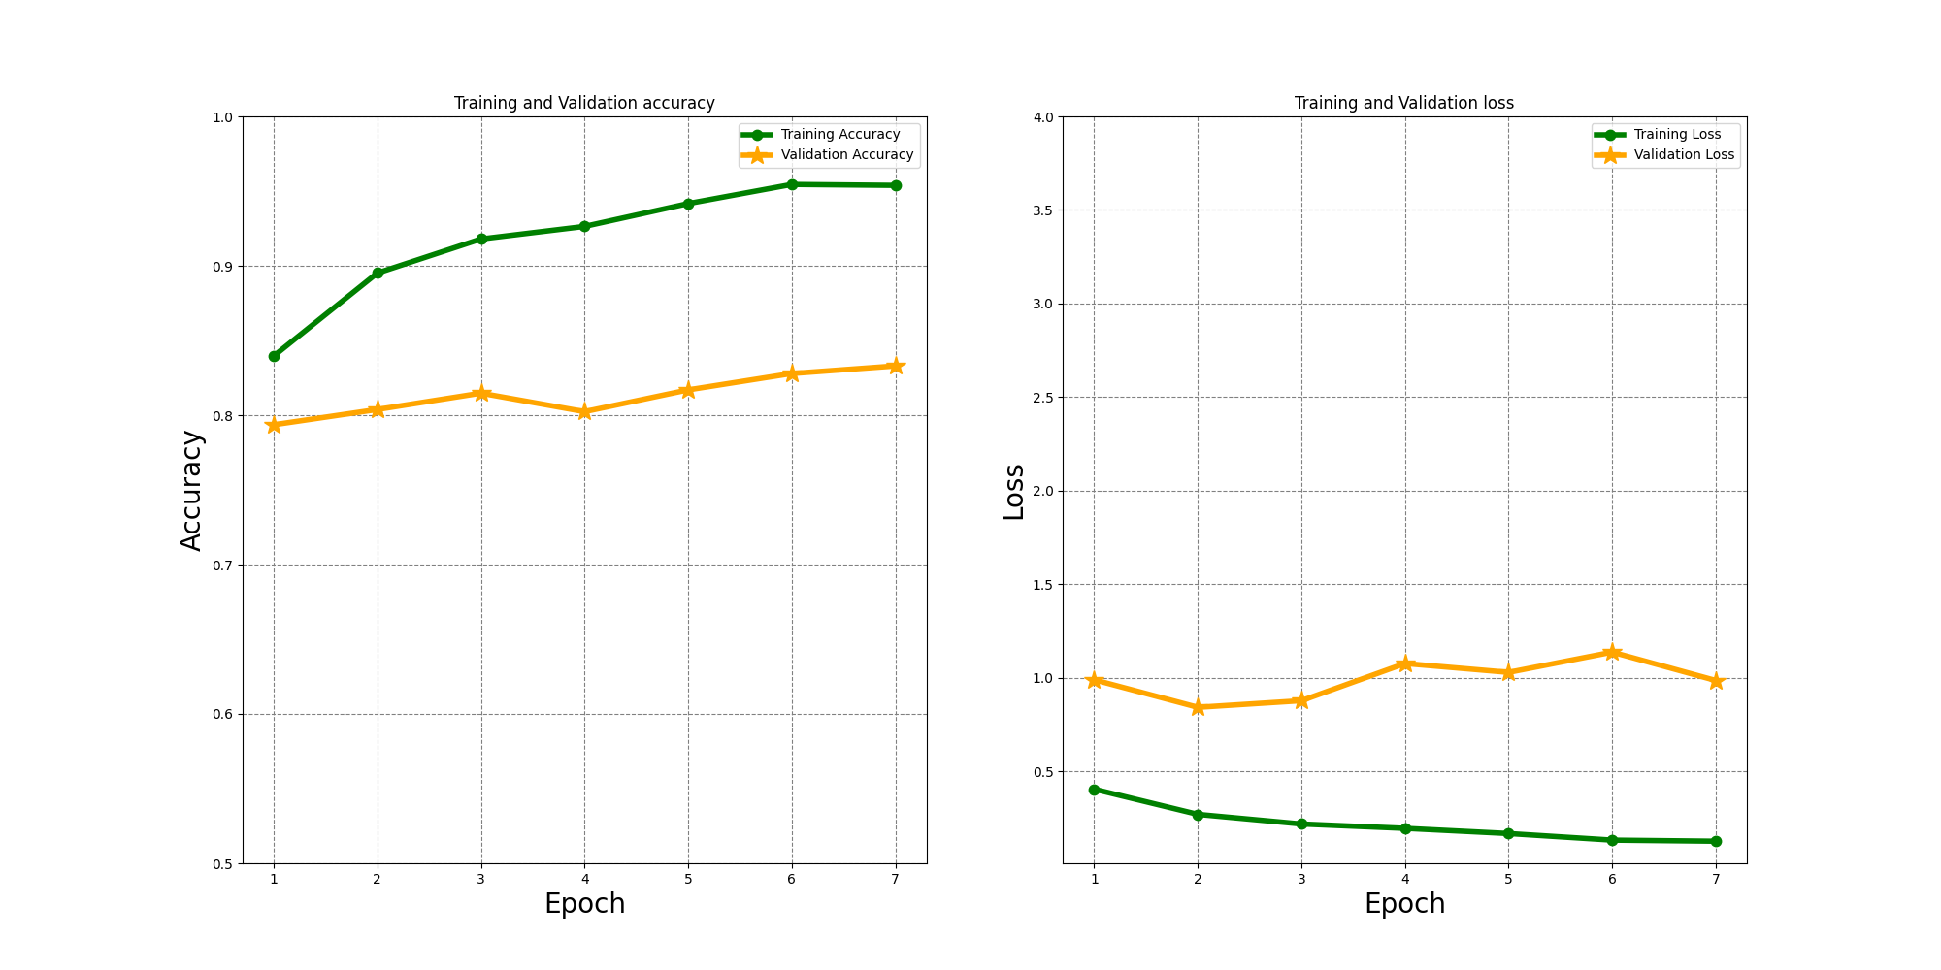
RESULTS
Training & validation accuracy : model achieved 90.01% and 80.38% train and test accuracy, respectively

Slide 10
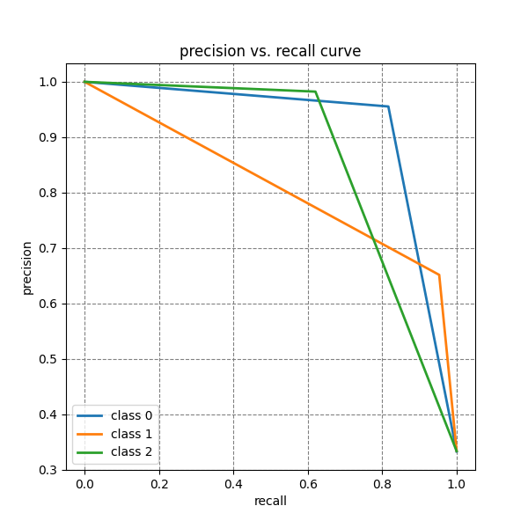
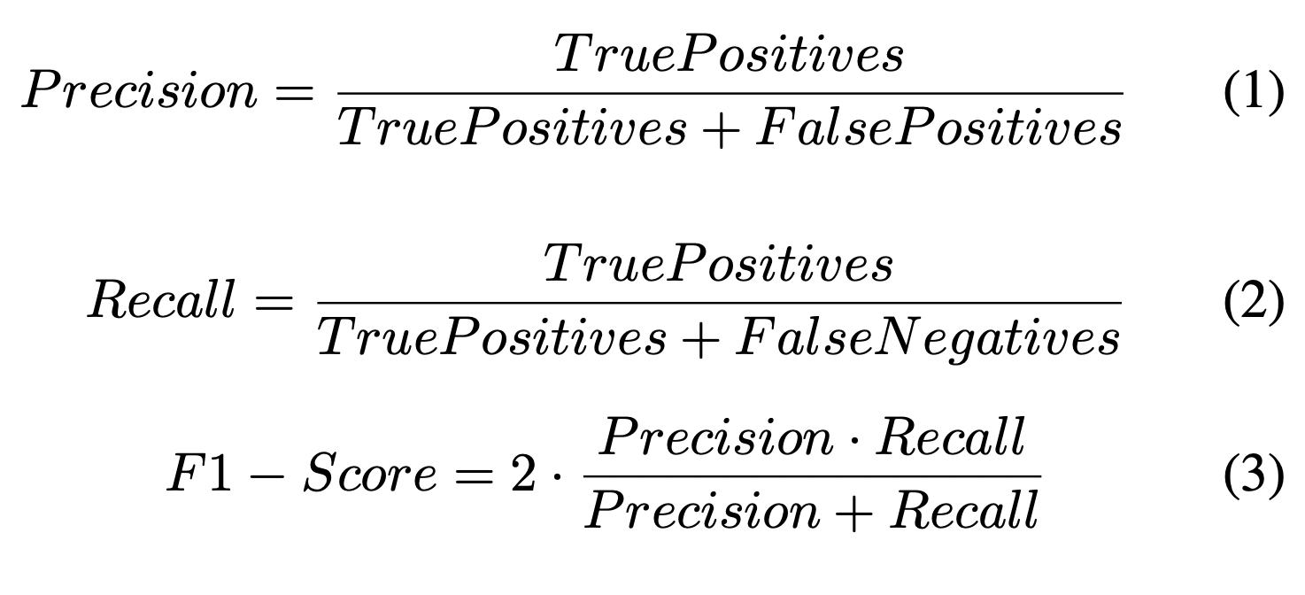
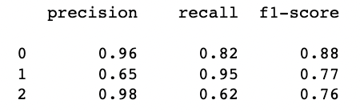
RESULTS
Precision (1), Recall (2), and F1-score (3) are used to evaluate the classification model performance
Class 0
COVID-19
Class 1
NORMAL
Class 2
PNEUMONIA

Slide 11
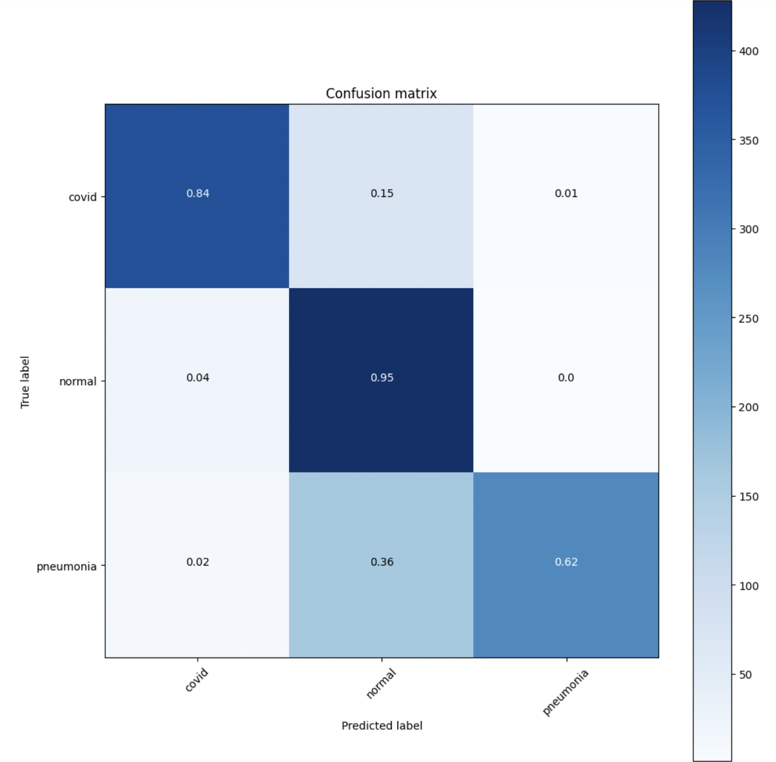
RESULTS
A confusion matrix for the test dataset
Best class per different Performance metrics:
Precision:
pneumonia
Recall:
normal
F1-score:
Covid

Slide 12
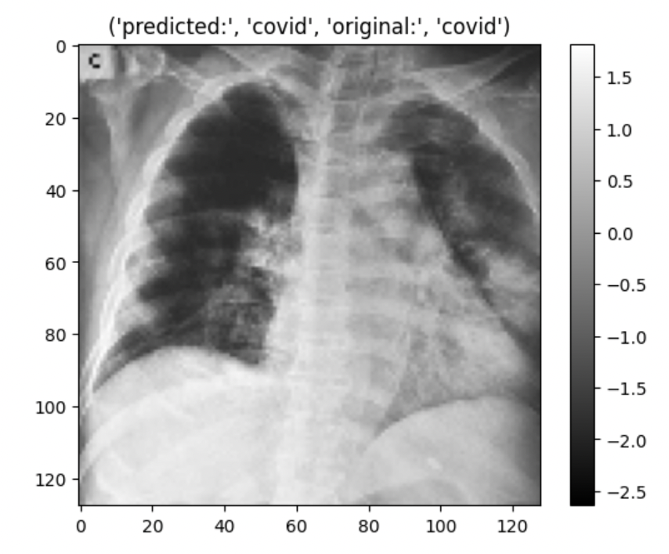
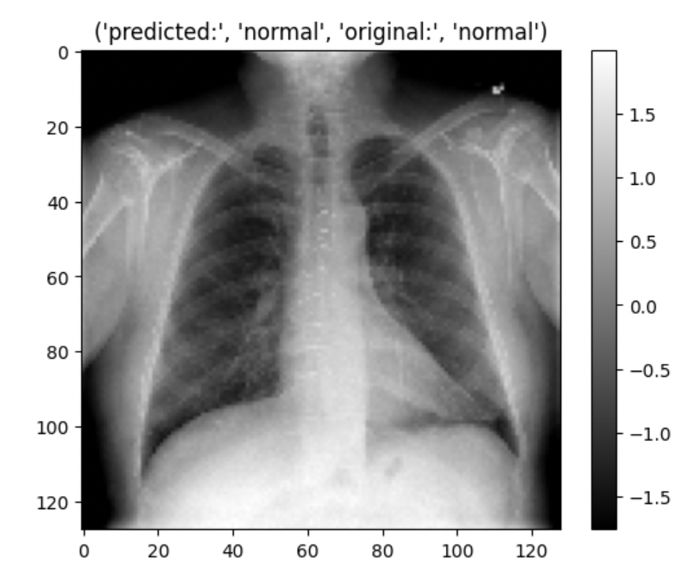
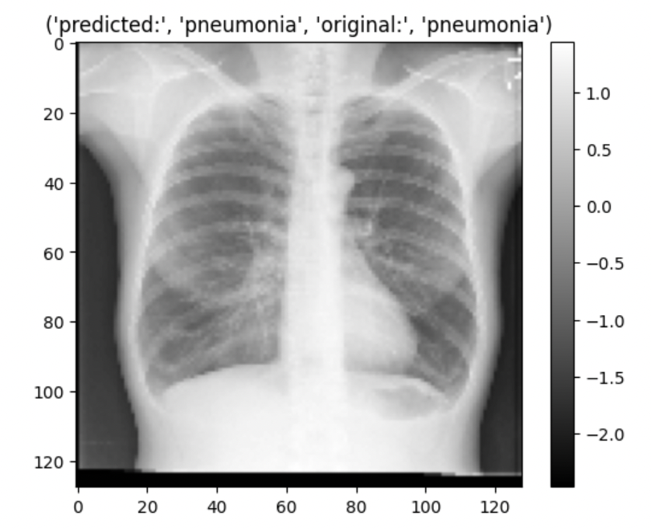

Model Performance of CNN
Demo : one sample per each class of images from a batch of test dataset to show the prediction.
Predicted : Covid
Original : Covid
Predicted : Normal
Original : Normal
Predicted : Pneumonia
Original : Pneumonia

Slide 13
Pre-trained DenseNet
(Base-model)
DenseNet121
GlobalAveragepooling2D
Dense (3)
CLASS 0 = COVID-19
CLASS 1 = NORMAL
CLASS 2 = PNEUMONIA
Softmax activation function

Slide 14

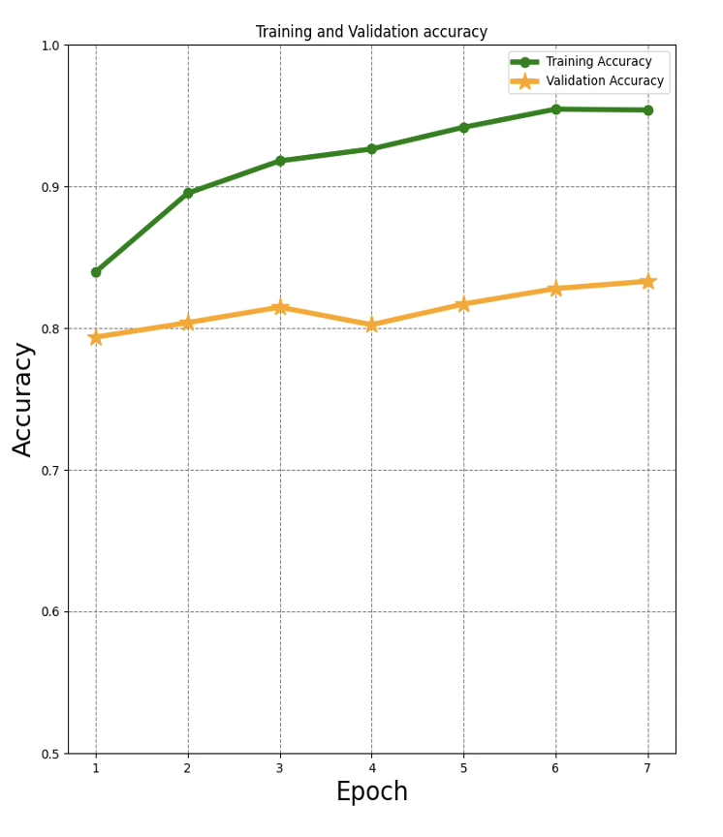
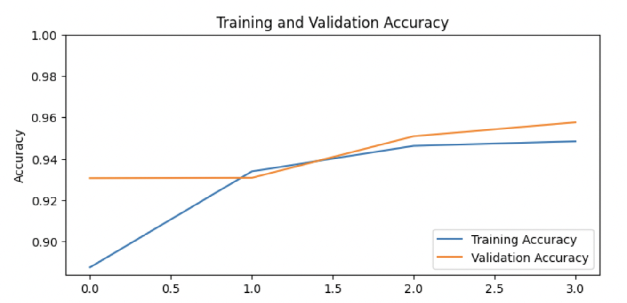
c
COMPARISION:
CNN
Convolutional Base
(DenseNet121)
Test accuracy : 80.37 %
Test accuracy : 95.76 %
.

Slide 15
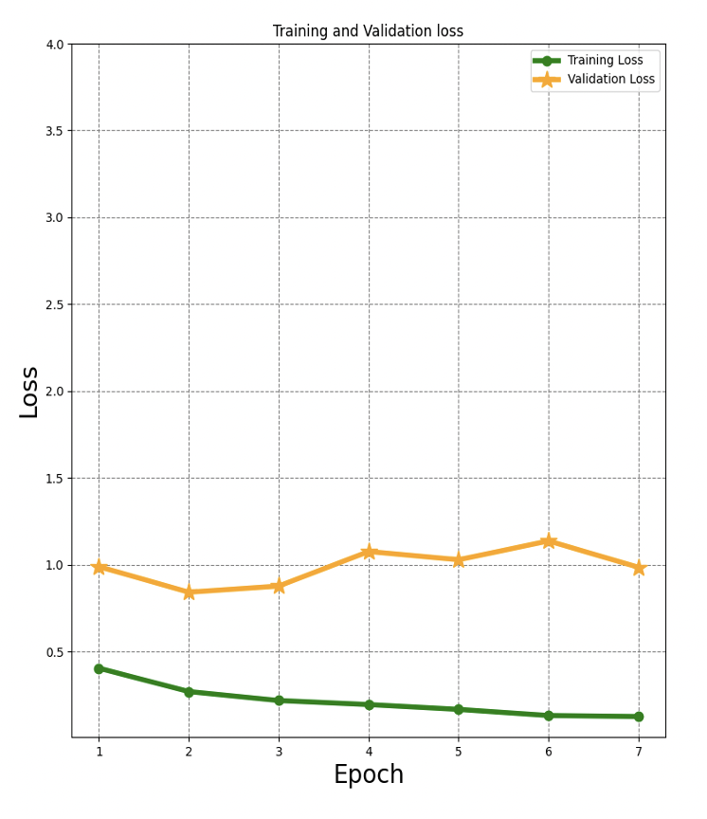
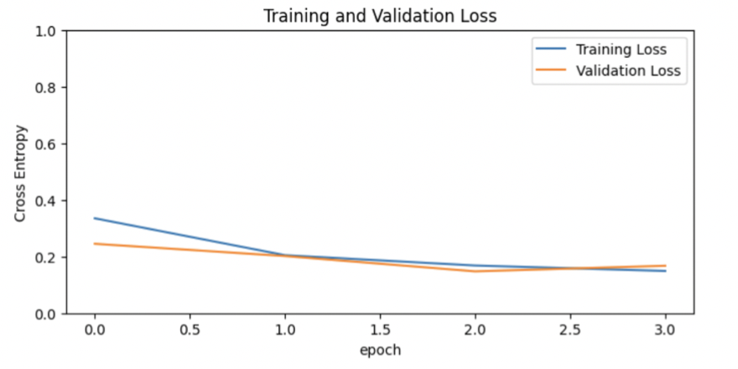
c
COMPARISION:
CNN
Convolutional Base
(DenseNet121)
Training and validation loss
Training and validation loss
.

Slide 16

THANK YOU
QUESTIONS ARE WELCOME

